Slide 1
Evolutionary Algorithms
(COMP6202)
Richard A. Watson
raw1@soton.ac.uk
(Agents, Interaction & Complexity, ECS)

Slide 2
Stochastic local search → evolutionary algorithms
Hill-climber
  Start with a random solution
  Repeat
    Make a random change to it:
      If the change is an improvement, keep it. Else discard it/keep original.
A hill climber described differently
  Make two random individuals
  Repeat
    Make variant of the better individual, replace less fit individual
    (or, make two variants of the better individual, replace current individuals)

Slide 3
Evolutionary algorithms
  Like a hill-climber but with a population
    Make P random individuals
    Repeat
      Make variations of the better ones, discard the not so good.
The supposed value of a population
  Some individuals might be luckier than others and we can preferentially focus on the better ones
  We can generate new solutions from a bit of one combined with a bit of another

Slide 4
Four requirements for evolution by natural selection
Reproduction (multiplication)
Heritability (offspring similar parent(s))
Variation (differences)
Change in fitness (variations cause differences in reproductive success)
Repeat k times
  Copy(A) → B
B ≈ A
Vary(Copy(A)) → B
(Or Vary(Copy(A1),Copy(A2))→B)
B1 ≠ B2 ≠ B3
Repeat (Quality(A)) times
  Vary(Copy(A)) → B

Slide 5
Evolutionary Algorithm – outline 1.0
Initialise P ‘individuals’
Until (satisfied or no further improvement)
  Create new individuals from variations of better individuals
Output best individual

Slide 6
Evolutionary Algorithm – outline 1.1 (no crossover)
Initialise P ‘individuals’
Until (satisfied or no further improvement)
  Evaluate all individuals
  Reproduce individuals into new population with probability proportional to quality
  Mutate individuals in new population
Output best individual

Slide 7
Evolutionary Algorithm – outline 1.2 (no crossover)
Initialise P ‘individuals’ → Pop
Until (satisfied or no further improvement)
  Evaluate all individuals
  For i=1 to P; Quality(Pop[i])→Fitness[i]; End
  Reproduce with variation
  For i=1 to P;
    Pick individual j with probability proportional to fitness
    Pop2[i]=Pop[j];
    Pop2[i]=mutate(Pop2[i]);
  End
  Pop2→Pop;
Output best individual

Slide 8
Necessary components of an EA
Representation of individuals
  Creation/initialisation of random individuals
Fitness function
  To assess quality of individuals
Selection
  Pick individuals proportional to fitness
  Or just pick fitter individuals with higher chance than less fit individuals
Variation operators
  Mutation
  Crossover or recombination

Slide 9
Representation of individuals
Evolve a solution to a function optimisation problem
  The function takes 20 binary arguments
  E.g. 00101110101000010111
Or solutions to a Travelling salesperson problem:…
  8 cities A,B,C,D,E,F,G,H
  E.g. BHGADCEF
Or positions of drilling sites: set of (x,y) coordinates
  12,34, 22,34, 5,67, 34,234, 44,53, 27,66
Or weights for a neural network: 3 nodes fully connected = 9 weights (including self connections)
  0.01, 1.24, 3.42, -0.91, -2.03, 1.71,-0.08, 4.22, 1.11
LISP s-expressions
  (div (+ 2 a) (sin (* - a 2) b)))
Graphs, circuits, creatures, automata rules, …

Slide 10
Fitness functions
Fitness (00101110101000010111) = 23.2
  Put arguments in optimisation function
Fitness (BHGADCEF)= 34.8
  Length of tour
Fitness(12,34, 22,34, 5,67, 34,234, 44,53, 27,66) = 3389.2
  Oil yield from a simulation of oil field
Fitness(0.01, 1.24, 3.42, -0.91, -2.03, 1.71,-0.08, 4.22, 1.11) = 12.3
  Run network with these weights, assess behaviour compared to desired behaviour

Slide 11
Necessary components of an EA
Representation of individuals
  Creation/initialisation of random individuals
Fitness function
  To assess quality of individuals
Selection
  Pick individuals proportional to fitness
  Or just pick fitter individuals with higher chance than less fit individuals
Variation operators
  Mutation
  Crossover or recombination

Slide 12
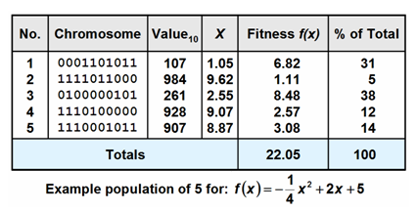
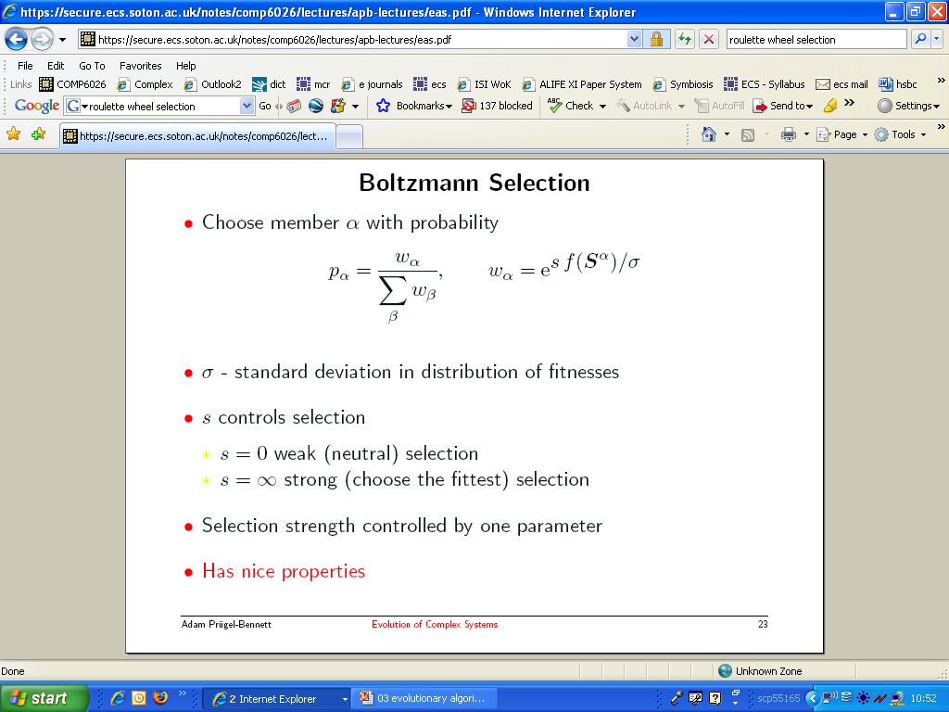
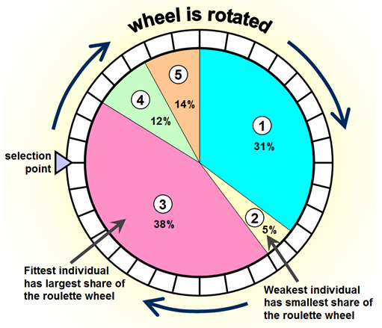
Selection
Fitness proportionate selection
  Using ‘roulette wheel’
i.e.
Make wheel
  sum=0
  For i=1 to P
    Sum=Sum+ fitness(pop(i))
    Wheel[i]=Sum
  End
Pick from wheel
  pick=Rand()*Sum
  i=1
  Until (wheel(i)>=pick)
    i++
  End
  Return(pop(i))

Slide 13
Boltzmann selection

Slide 14
Stochastic Universal Sampling
Under roulette wheel
  Whats the most offspring an individual can have?
  Whats the least offspring an individual can have?
SUS uses roulette wheel, but instead of using one pointer and ‘spinning the wheel’ P times, use P pointers (equally spaced) and spin the wheel once.
Much less variation in number of offspring than regular roulette wheel sampling
Integer part guaranteed

Slide 15
Selection II
Tournament selection
  i.e.
  P1=pop(rand()*P)
  P2=pop(rand()*P)
  If (fitness(P1)>fitness(P2)) return P1
  Else return P2.
More generally, pick k individuals and return individual with greatest fitness

Slide 16
Selection III
Truncation selection
  Pick any individual in top half of population fitnesses
Rank-based selection
  Pick individual with probability proportional to rank (worst fitness has rank 1)
  Or
  Pick individual with probability proportional to 1/rank (best fitness has rank 1)

Slide 17
Necessary components of an EA
Representation of individuals
  Creation/initialisation of random individuals
Fitness function
  To assess quality of individuals
Selection
  Pick individuals proportional to fitness
  Or just pick fitter individuals with higher chance than less fit individuals
Variation operators
  Mutation
  Crossover or recombination

Slide 18
Variation operators I: mutation
mutate(00101110101000010111) =
00101110101010010111
mutate(BHGADCEF) = BHEADCEF
Plus repair: BHEADCGF
mutate(12,34, 22,34, 5,67, 34,234, 44,53, 27,66) =
12,34, 23,34, 5,67, 34,233, 44,53, 27,66
mutate(0.01, 1.24, 3.42, -0.91, -2.03, 1.71,-0.08, 4.22, 1.11)
-0.005, 1.24, 3.42, -0.91, -2.29, 1.71,-0.08, 4.22, 1.11) =

Slide 19
Variation operators II: crossover
Analogue of sexual reproduction
E.g. ‘one-point crossover’
Parent 1= 00101110101000010111
Parent 2= 00010100111101010101
Offspring= 00101110111101010101
E.g. ‘two-point crossover’
Parent 1= 00101110101000010111
Parent 2= 00010100111101010101
Offspring= 00101110111101010111
  http://www.ads.tuwien.ac.at/raidl/tspga/TSPGA.html
E.g. ‘uniform crossover’
Parent 1= 00101110101000010111
Parent 2= 00010100111101010101
Offspring= 00111100111001010101

Slide 20
Evolutionary Algorithm – outline 2.0 (w. crossover)
Initialise P ‘individuals’ → Pop
Until (satisfied or no further improvement)
  Evaluate all individuals
  For i=1 to P; Quality(Pop[i])→Fitness[i]; End
  Reproduce with variation
  For i=1 to P;
    Pick individual j with probability proportional to quality
    Pick individual k with probability proportional to quality
    Pop2[i]=crossover(Pop[j],Pop[k]);
    Pop2[i]=mutate(Pop2[i]);
  End
  Pop2→Pop;
Output best individual

Slide 21
Variations on a theme

Slide 22
Steady state vs generational
Steady state (reproduction ‘with replacement’)
  Until done
    Pick one parent (or two if using crossover) for reproduction
    Generate offspring with variation
    Put offspring back into population
Generational (reproduction w/o replacement)
  Until done
    Repeat P times
      Pick one parent (or two if using crossover) for reproduction
      Generate offspring with variation
      Put offspring into NEW population
    Current population=new population
Very little difference
  Steady state – much simpler code
  Generation – more traditional, easier to manipulate selection pressure

Slide 23
Other Evolutionary Algorithm schools
GA: genetic algorithms
  Binary representation
  Crossover important
ES: Evolutionary strategies
  Real-valued representations
  No crossover
  Evolved mutation rate
GP: Genetic programming
  For evolving programs
  Specifically, LISP s-expressions
EP: evolutionary programming
  finite state automata
  Mutation only

Slide 24
Parameters – black art of ~
Population size
  Too big?
    – waste of time
  Too small?
    – no useful diversity in population
Mutation rate and crossover rate
  Too low?
    – too little innovation
  Too high?
    – too much destruction
Choosing a good representation/designing the fitness function
  →fitness landscapes (lecture 4)
‘Selection pressure’
  Fitness scaling via: Boltzmann selection, rank-based, tournament size, truncation fraction
  diversity maintenance methods

Slide 25
Qs
What components are required in an evolutionary algorithm?
  How are individuals represented in the ‘methinks’ example?
  What’s the fitness function in the ‘methinks’ example?
  What’s one way to do selection?
  What types of variation are there?
Why might an evolutionary algorithm be better than a hill-climber?
What differences are there between evolution in nature and evolutionary algorithms?
What type of GA do we use in assign 1?

